Slide 1
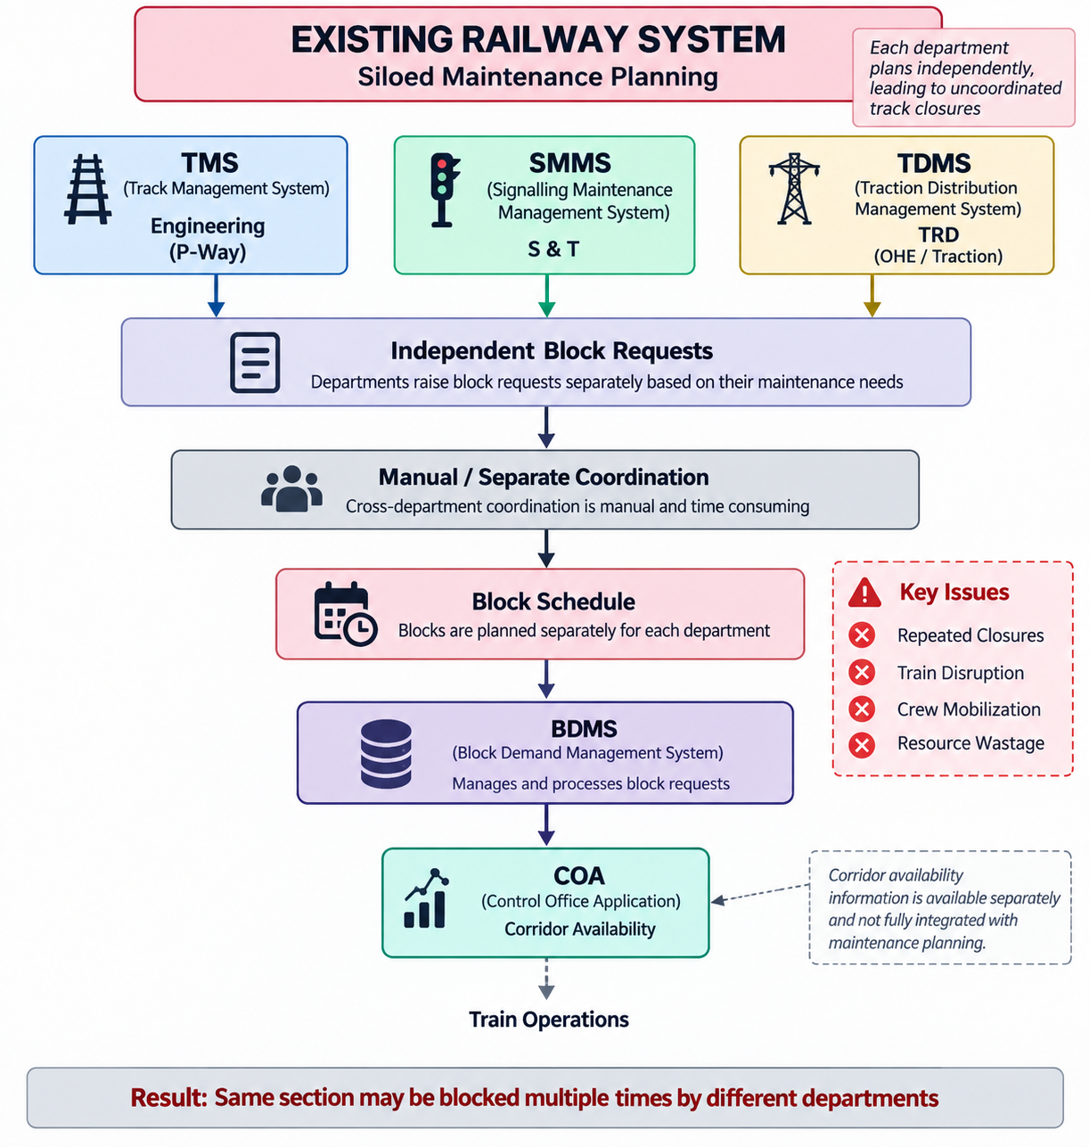
RailSahayak — AI-Driven Block Optimization for Indian Railways
AIH
01 • WHY THE PROBLEM EXISTS
Track, S&T and OHE teams may need access to the same section — while train operations must continue around those windows.
THE OPERATING PROBLEM
TODAY | Independent isolated planning
TMS / SMMS / TDMS
Multiple departments compete for the same limited operational windows for maintenance — while train operations must continue around those windows.
Maintenance inputs
Each department raises needs
Independent block requests
Manual / separate coordination
Shared-resource framing: the block window is a common planning problem, even when requests are created separately.
Conflicts resolved across teams
Block schedule
Blocks planned separately
Operational execution
BDMS → COA → train operations
TODAY | ISOLATED MAINTENANCE PLANNING
Risk to avoid : the same section may be blocked multiple times
WHY THIS IS A COORDINATION PROBLEM
The requests may be separate; the operational window is not. Planning must consider the combined picture.
WHAT THIS CAN CREATE
Current gap:
Corridor availability data is isolated from maintenance planning.
• Avoidable conflicts
• Repeated closures
• Crew / resource mobilization
• Train disruption risk
WITH RAILSAHAYAK | COORDINATED PLANNING
REQUESTS
Maintenance needs
CONTEXT
Timetable • freight • weather
PRIORITIZE
Criticality • urgency • impact
PREDICT / OPTIMIZE
ML / forecasting + Constraint Programming (CP) & Satisfiability (SAT)
PLAN
Coordinated 7-Day / 30-Day block plan
EXECUTE + UPDATE
Block and Disconnection Management System (BDMS) → controller → field + status feedback
Design intent from the original concept: cross-department bundling • low-connectivity field communication • status updates • fewer repeated closures • better asset availability
RailSahayak • Smart India Hackathon 2026 • Problem Statement 26027
2 / 6
2

Slide 2
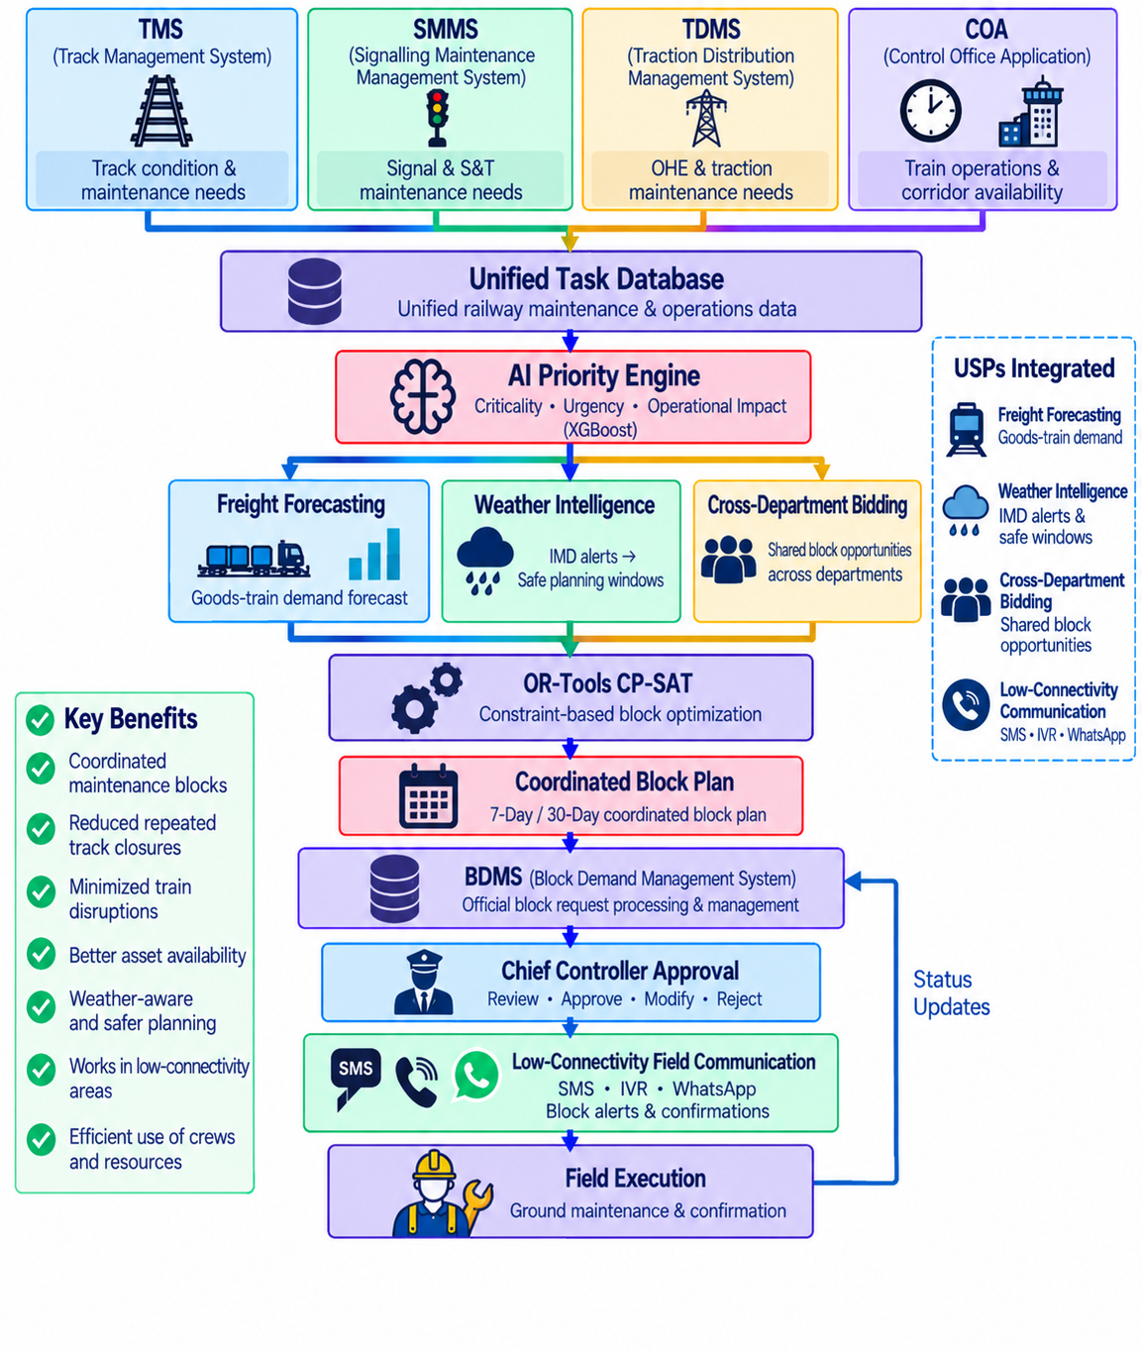
AIH
TECHNICAL APPROACH
RailSahayak
AI-assisted block planning to improve asset availability while minimizing disruption to train operations.
COORDINATE
OPTIMIZE
CONTROL
Bring maintenance requests together
Find feasible, high-value block windows
Keep authorized railway staff in the loop
How RailSahayak turns competing requests into a feasible plan
Three jobs work together: understand priority, anticipate operating context, then solve the constrained scheduling problem — with the authorized railway official making the final call.
1
REQUESTS
PRIORITY SCORE | WHY BLEND RULES + ML?
TMS • SMMS • TDMS
TASK DATA
RULE SCORER
ML ESCALATION
CONTEXT
rule_score 0–10
probability 0–1
2
Timetable • freight • weather
Final Priority Score = blend of both
RULE-BASED
ML | ESCALATION
Safety, criticality, overdue-ness; explainable; works even with zero historical data.
Past-failure patterns add a data-driven adjustment;
catches asset + season + traffic combinations.
3
PRIORITIZE
Criticality • urgency • impact
OPTIMIZE
DESIGN PRINCIPLE
4
Constraint-based scheduling
ML / forecasting informs the decision → CP-SAT searches feasible schedules → human authority makes the final call.
5
REVIEW
Parameters to set
Chief Controller
Operational availability • incompatible overlaps • timing windows • railway rules validated with domain experts.
OBJECTIVES TO BALANCE
Useful maintenance completed • fewer conflicts • better window utilization • lower operational disruption.
6
EXECUTE
Field communication
Concept benefits carried from the original solution:
• coordinated maintenance blocks • reduced repeated closures • minimized train disruption
• better asset availability • weather-aware safer planning • low-connectivity communication • efficient crew / resource use
3 DISTINCT JOBS
01 PRIORITIZE
02 PREDICT / CONTEXTUALIZE
03 OPTIMIZE
Finally giving Coordinated block plan
Outcome: fewer avoidable conflicts • better use of maintenance windows
Work / asset priority
Freight / train demand + weather
Feasible block plan
XGBoost / ML
Forecasting inputs
OR-Tools CP-SAT
1 / 6
RailSahayak • Smart India Hackathon 2026 • Problem Statement 26027
3

Slide 3
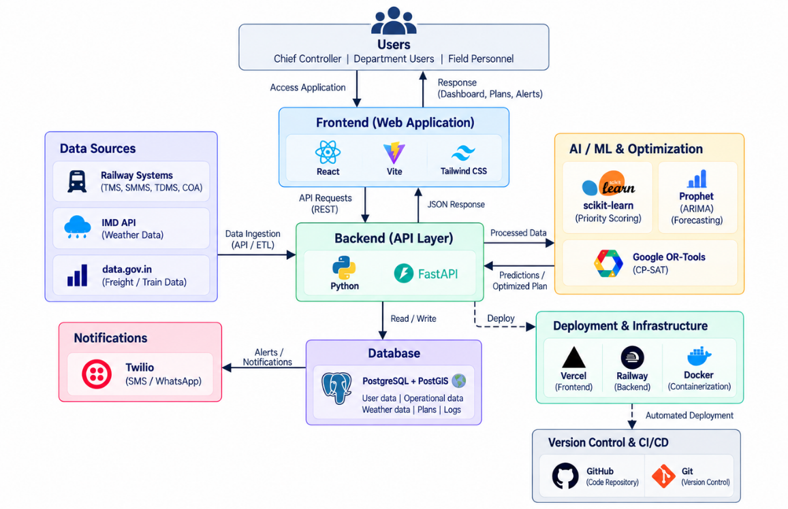
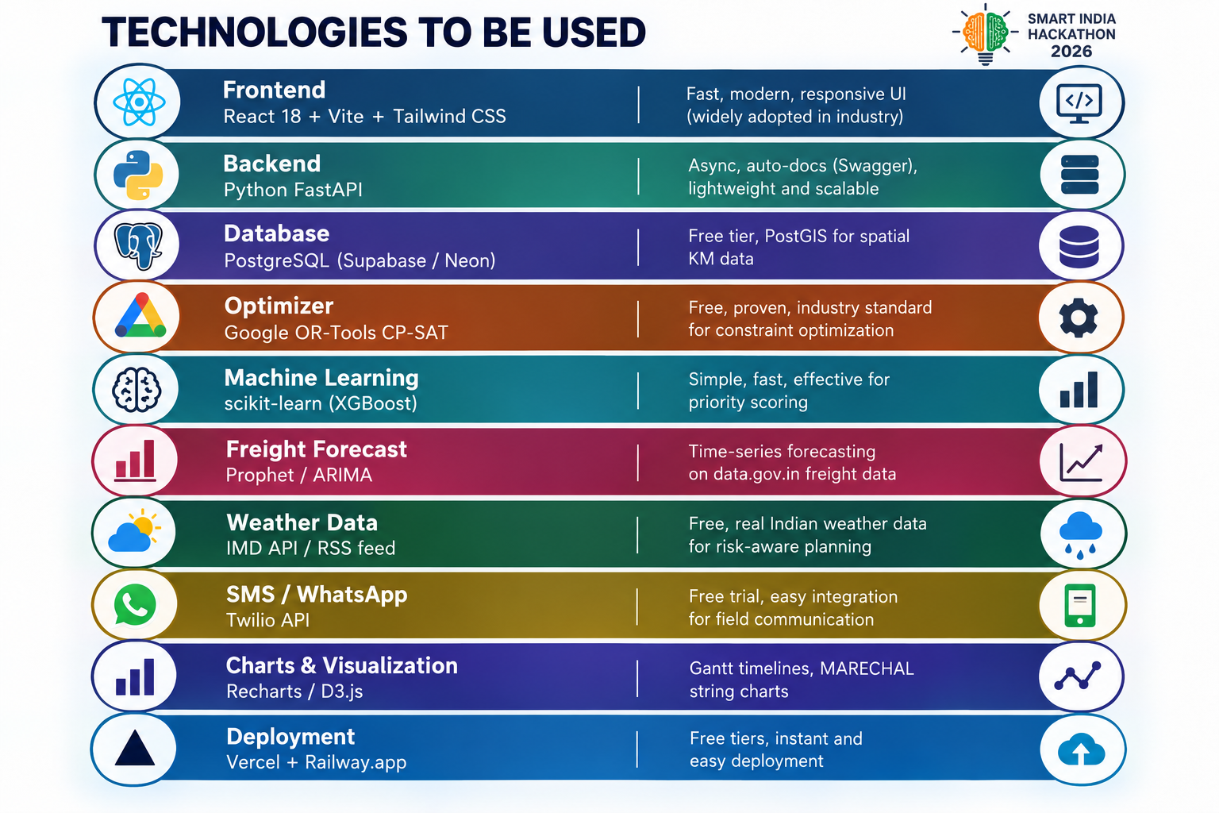
03 • ARCHITECTURE + FEASIBILITY
Built around existing railway systems — not a replacement
RailSahayak is a decision-support planning layer: existing operational data stays in place; the new layer unifies it, applies intelligence / optimization and returns a reviewable plan.
SYSTEM ARCHITECTURE | PROTOTYPE
PROTOTYPE TECHNOLOGY STACK
Frontend / backend / database / ML / forecasting / CP-SAT / communications / deployment.
INTEGRATION + OPERATIONAL SAFEGUARDS
TMS • SMMS • TDMS • COA • BDMS + IMD weather / data.gov.in
Hard constraints • human approval • review / modify / reject • execution-status feedback
ESTABLISHED IN CONCEPT / PROTOTYPE: system inputs • modular architecture • AI/ML + constraint workflow • prototype network / explainability views | REQUIRES PILOT EVIDENCE: planning-time reduction • conflicts / duplicates • utilization • forecast / priority accuracy • production reliability / field adoption
Feasibility framing: technically credible and staged; production integration, safety validation and operational-rule mapping remain pilot-stage activities. Source basis: CRIS • Indian Railways • data.gov.in.
4 / 6
RailSahayak • Smart India Hackathon 2026 • Problem Statement 26027
4

Slide 4
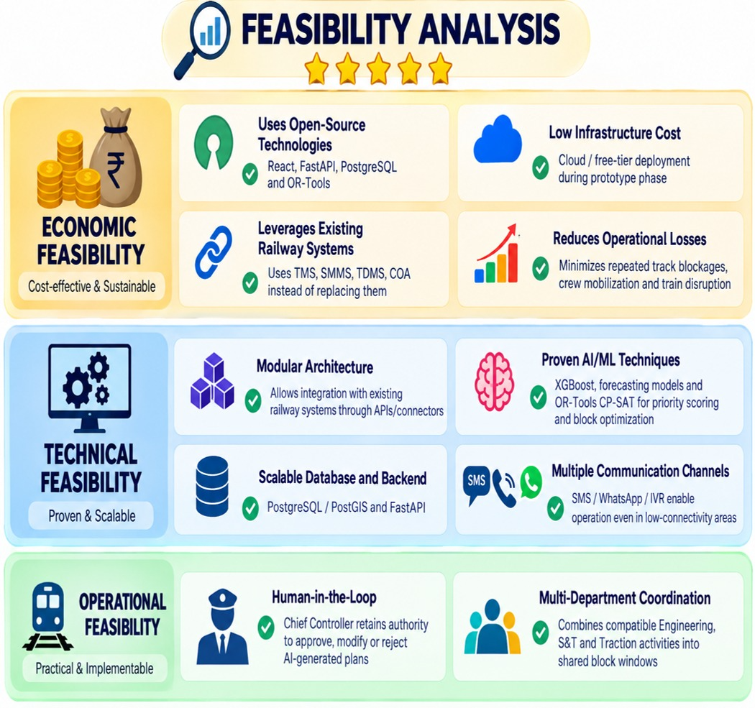
05 • IMPACT + DEPLOYMENT
What success should look like — and how we will prove it
Expected benefits become evidence only through a controlled pilot, an agreed baseline and measurable outcomes.
ASSET AVAILABILITY
TRAIN OPERATIONS
FEASIBILITY ANALYSIS | ORIGINAL CONCEPT
More productive use of available maintenance windows
Fewer avoidable conflicts between maintenance & train movement
RESOURCE UTILIZATION
PLANNING EFFORT
Better coordination of crews / work packages across departments
Less manual coordination and faster candidate-plan generation
PILOT KPI FRAMEWORK
Metric | Direction | Why it matters | Baseline / result
Planning cycle time | ↓ | Planner productivity | Establish baseline
Conflicting / duplicate blocks | ↓ | Coordination quality | Establish baseline
Productive block utilization | ↑ | Asset availability | Establish baseline
Maintenance work completed per block | ↑ | Value of each closure | Establish baseline
Train disruption attributable to block conflicts | ↓ | Operational impact | Establish baseline
Baseline = existing planning practice before pilot • no performance percentage is claimed until baseline + controlled pilot exist.
Economic + technical + operational feasibility framing from the supplied deck; production performance still requires pilot validation.
PILOT ASK
DATA
Selected maintenance + timetable / operational data
DOMAIN
Railway expert validation of rules & constraints
PILOT
Defined division / corridor + planning horizon
MEASUREMENT
Agreed KPIs + baseline
THE PROMISE | Make the maintenance window work harder — while keeping railway decision-makers in control. • No measured-impact claim without baseline evidence.
6 / 6
RailSahayak • Smart India Hackathon 2026 • Problem Statement 26027
4

Slide 5
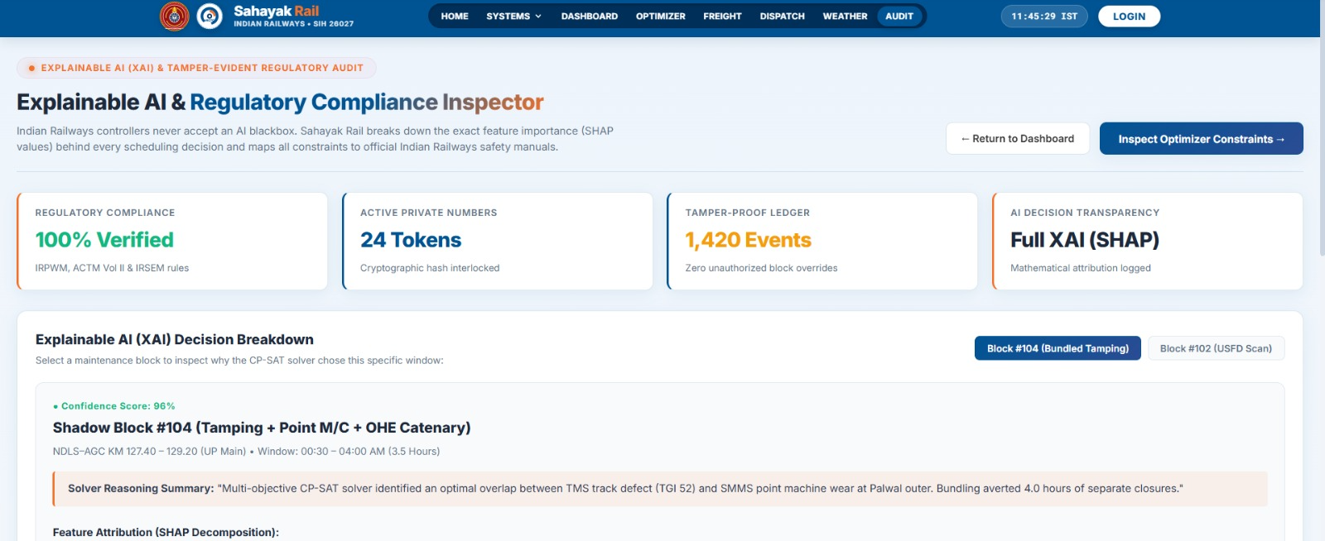
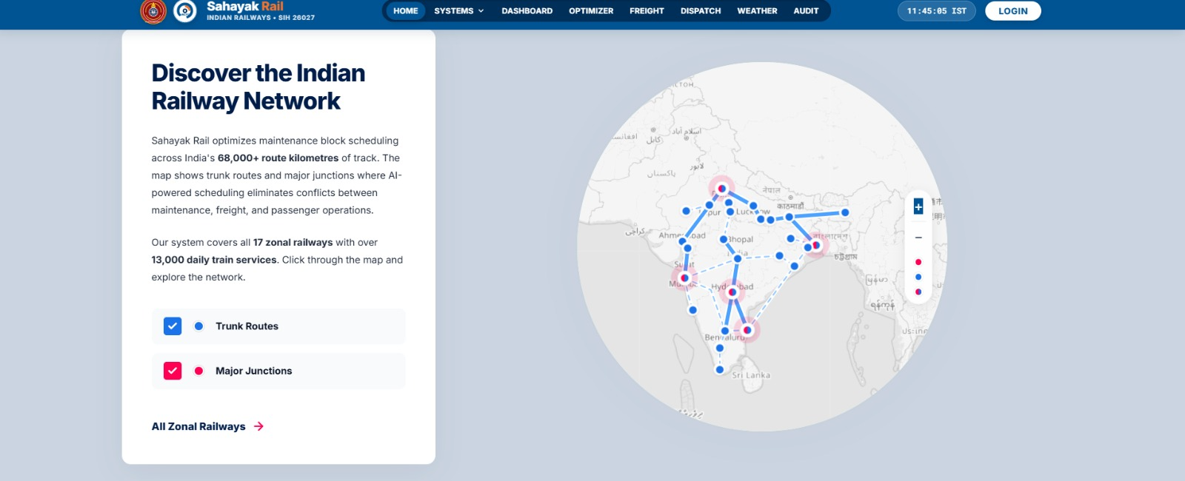
04 • TRUST + PROTOTYPE
AI recommends. Constraints validate. The railway official decides.
The current prototype demonstrates intelligence / explainability and railway-network context. The next proof point is one complete real planning cycle.
APPROVE
MODIFY
REJECT
Prototype view • explainability / compliance concept
Prototype view • Indian railway network context
HUMAN-IN-THE-LOOP GOVERNANCE
RECOMMENDED DEMONSTRATION JOURNEY
Candidate plan
Constraint check
Explain recommendation
Controller
1
2
3
4
5
6
7
The architecture shown in the original concept keeps the Chief Controller as the authority to approve, modify or reject the generated plan.
APPROVE
MODIFY
REJECT
Request
Context
Optimize
Explain
Approve
Execute
Update
KEY PILOT PROOF POINT
Show one real planning cycle from competing requests → conflict → recommended coordinated schedule → explanation → approval → execution status.
Explainability should answer “Why this block?” — priority, traffic context, weather / context, compatible work and constraint checks. This is a pilot design principle, not a claim that every production control is already certified.
Prototype caveat: screenshots reproduce the supplied UI concepts / values; they are prototype views, not production performance evidence. The map can serve as the visual layer for affected sections / block plans.
RailSahayak • Smart India Hackathon 2026 • Problem Statement 26027
5 / 6

Slide 6


RESEARCH AND REFERENCES
Research link
Prototype
[1] Centre for Railway Information Systems (CRIS), “CRIS Official Website.” [Online]. Available: CRIS Official Website
[2] Centre for Railway Information Systems (CRIS), “CRIS Projects & Railway Systems.” [Online]. Available: CRIS Projects & Railway Systems
[3] Centre for Railway Information Systems (CRIS), “Track Management System (TMS).” [Online]. Available: CRIS Track Management System
[4] Government of India, “Freight and Passenger Movement Data,” Data.gov.in. [Online]. Available: Data.gov.in
[5] Indian Railways, “Rolling Block Planning Study,” 2023. [Online]. Available: Indian Railways Rolling Block Planning Study
[6] Indian Railways, “Indian Railways Year Book 2023–24.” [Online]. Available: Indian Railways Year Book 2023–24
6

